Slide 1
Resume Parser
Syed Hani Haider, Dinesh Pappuru, Nikitha Kanaparthi

Slide 2
Motivation
Motivation
To make the recruiting process easier and efficient.
NLP for resume screening: Extracting relevant text from resumes using statistical and machine learning models.
Managing high volume: Efficiently sorting through millions of applications with machine learning algorithms.
Enhancing accuracy: Using machine learning classifiers to calculate accuracy and performance in resume screening.
Kaggle resume dataset:
962 rows
24 categories
Notes:
Resume screening using NLP: NLP enables the system to find and extract relevant text from resumes based on English dictionary, combining statistical, machine learning, and deep learning models of human language with computational linguistics-based rule-based modeling.
Managing high volume of applications: With millions of applications received, sorting through them manually can be time-consuming. Machine learning algorithms can provide a more efficient and accurate way of understanding and fulfilling industry requirements in the resume screening process.
Enhancing accuracy and performance: The proposed system takes a CSV file as input with different categories and resumes, and uses machine learning classifiers to calculate accuracy and performance based on the category and features of the resumes, improving the overall screening process.

Slide 3
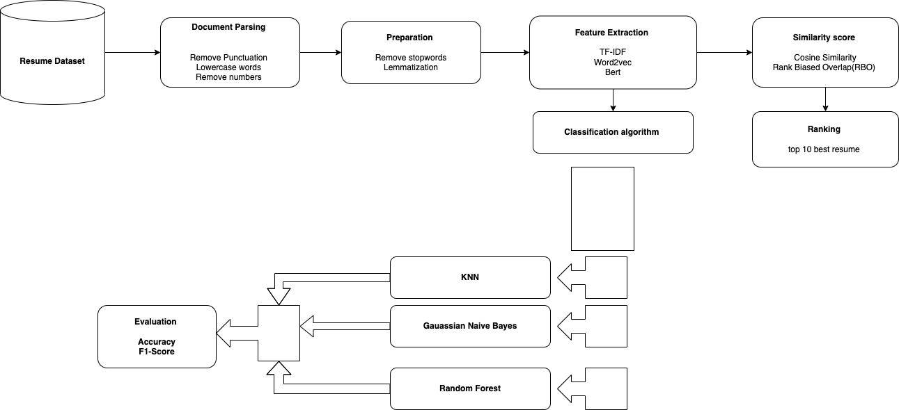
The Approach

Slide 4
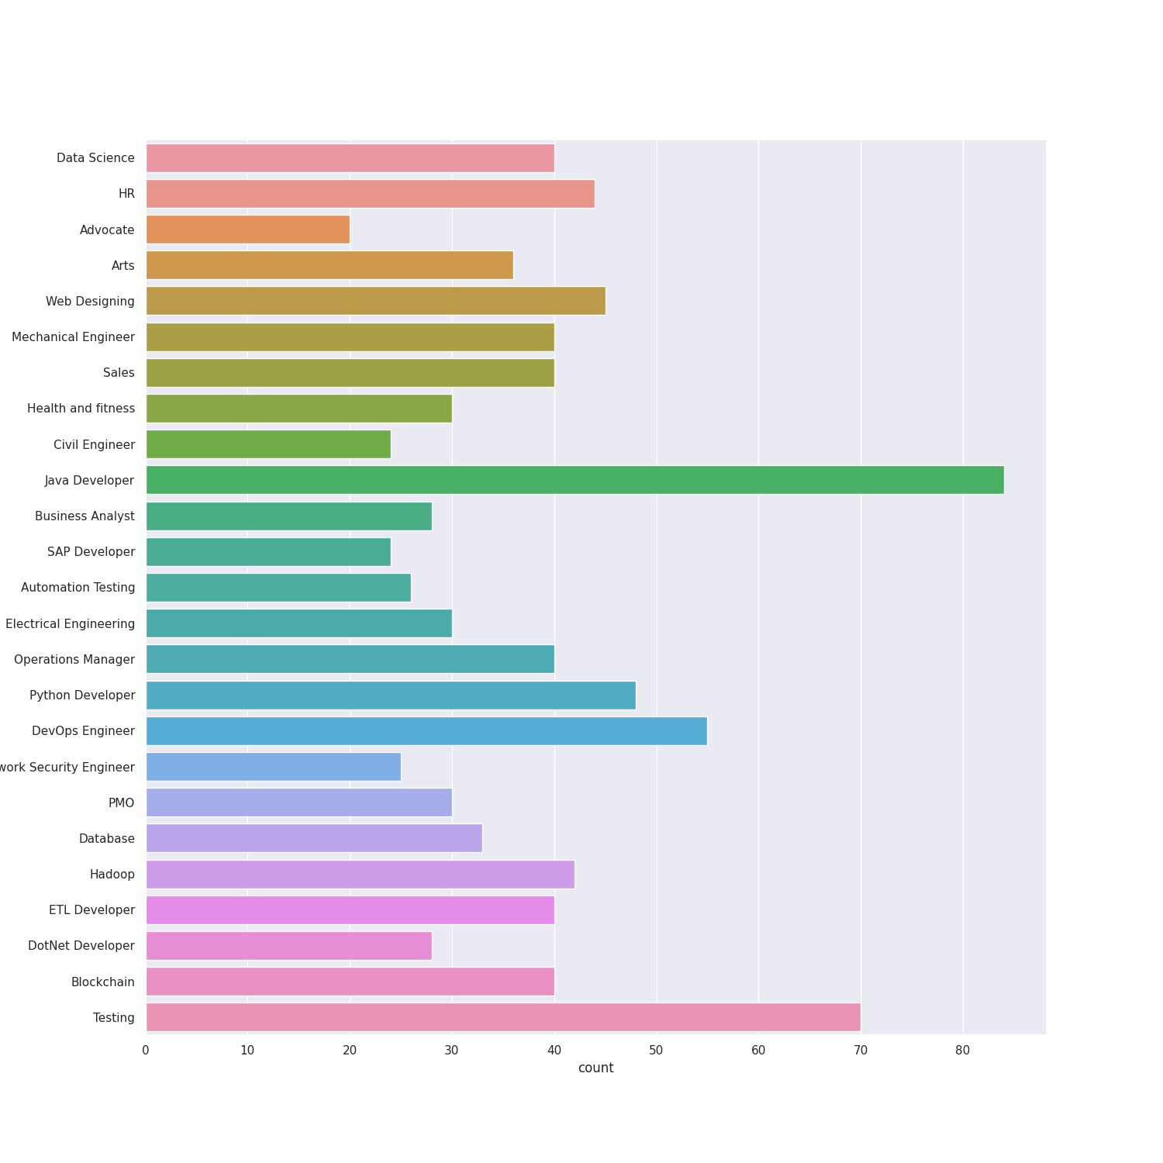
EDA
Word cloud and chart

Slide 5
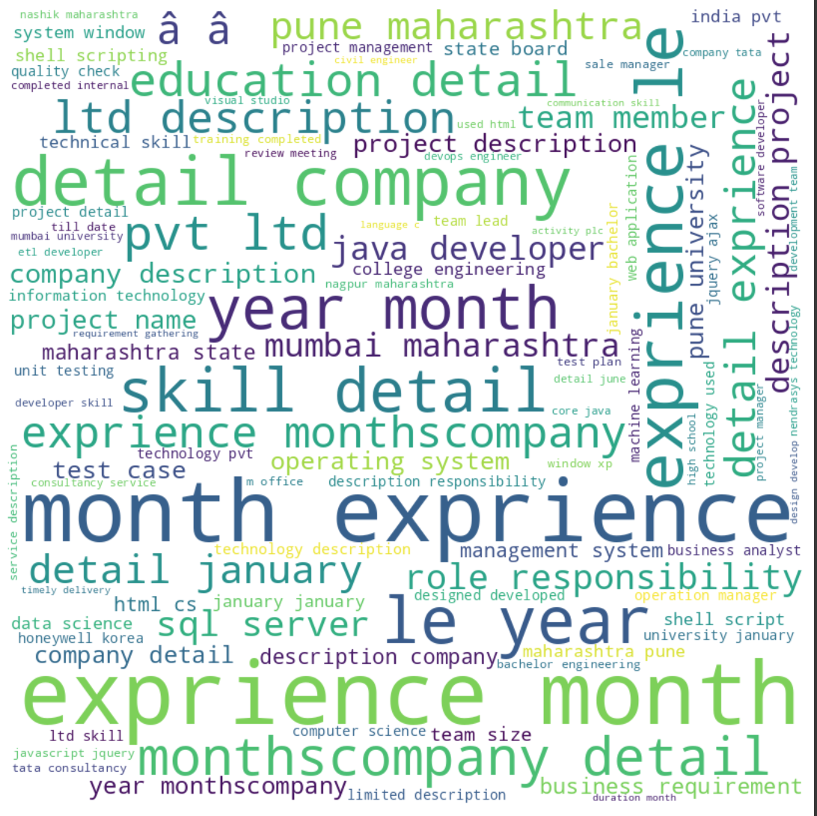
EDA

Slide 6
Embedding techniques
TF-IDF
Assign numerical weights to phrases using term frequency multiplied with inverse document frequency
WORD2VEC
Captures the semantic and syntactic relationships between words by assigning numerical values to words based on their meaning and surrounding words in a given corpus of text.
BERT
State-of-the-art NLP model.
Uses transformer architecture.
Trained on large amounts of data.
Generates contextualized word representations.
Understands word meaning in context.
Notes:
BERT (Bidirectional Encoder Representations from Transformers) is a state-of-the-art natural language processing (NLP) model that uses a transformer architecture and is trained on large amounts of data to generate contextualized word representations, allowing it to understand the meaning of words in the context of the sentences in which they appear.

Slide 7
TF-IDF
It is a statistical measure used to evaluate the importance of a word in a document or a corpus

Slide 8
Word2Vec
Word2vec generates numerical representations (embeddings) for words based on their semantic and syntactic relationships in a given corpus of text and enables algorithms to better understand the meaning and relationships between words in text data.
Using word2vec for resume classification and shortlisting helped improve accuracy and efficiency by generating high-dimensional vector representations of words that capture semantic and syntactic relationships, which were later used as input features for machine learning models and that in-turn helped improve the machine learning model’s accuracies.
The use of Word2Vec embeddings in combination with Random Forest helped the best to overcome some of the limitations of cosine similarity for the shortlisting aspect. The Random Forest model helped ensure that the Word2Vec embeddings are robust and representative of the resume content, and led to more accurate cosine similarity scores.

Slide 9
Image for tfid wor2vec and bets

Slide 10
Classification
 | TF-IDF- F1-score | Word2vec- F1-score | Bert
Random Forest | 0.97 | .96 | -
Gaussian Naive Bayes | .97 | .69 | -
KNN | 96 | .93 | -
Accuracy | - | - | 30*

Slide 11
Cosine Similarity
 | TF-IDF | Word2vec | Bert
AVG Similarity score | 0.24 | 0.35 | 0.45

Slide 12
Ranking Resume
Also write what is cosine similarity and RBO - explain

Slide 13
Conclusion

Slide 14
Thank you

